Slide 1


CCWD IT
Tech byte

Slide 2
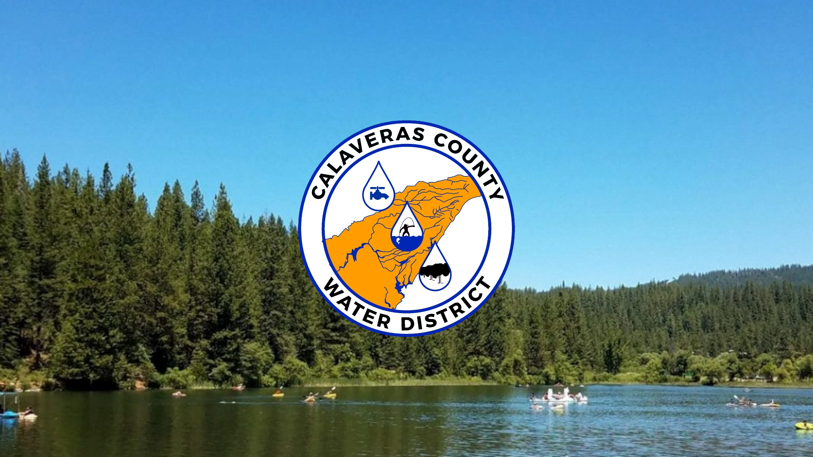

Internet Speeds
Challenges with Internet Service Providers (ISP)s
Support for Employees and Devices
Costs Savings
Grant Opportunity!

Slide 3
Internet Speeds Before and After

Slide 4

Internet service provider (ISP)
AT&T or Volcano (DSL)
Comcast (Cable)
Conifer Point-to-Point (P2P)
Cellular (AT&T or Verizon)
Starlink (Satellite)

Slide 5
Internet Service Provider Comparison
 | AT&T or Volcano (DSL) | Comcast (Cable) | Conifer Point-to-Point (P2P) | Cellular (AT&T or Verizon) | Starlink (Satellite)
Availability of Service | Throughout the County | Mostly along the major Highways | Line-of-sight to a tower they service | Mostly in higher populated areas | Line-of-sight to the sky
Performance Download | 1 Mbps – 15 Mbps | 25 Mbps – 1000 Mbps | 10 Mbps – 50 Mbps | 1 Mbps – 50 Mbps | 50 Mbps – 300 Mbps
Cost | ~$40 | ~$75 - $600 | ~$50 - $175 | ~$50 | ~$120 - $250

Slide 6

Support for Employees and Devices
Ability to Remote to Devices to assist
Keep devices up-to-date with the latest security software
Reasonable loading times for Employees to access needed resources

Slide 7
Cost Savings
IT Staff minimizes on-site visits
Issues are typically resolved within minutes
Security Event Response Time
Reduce waiting time for frequently accessed items
Adjusting our Microsoft 365 License
Researching better value vendors
Evaluating our software

Slide 8

Grant Opportunity
Possibility of up to $250,000 for Cybersecurity
Awarded in mid-November
Improve Cybersecurity in our critical infrastructure
Help our employees not only with Cybersecurity but allow them access to needed resources

Slide 9

Information Technology Department

